Slide 1
Computer Network
(Module 4)

Slide 2
Network Layer
The Network Layer is the third layer of the OSI model.
It handles the service requests from the transport layer and further forwards the service request to the data link layer.
The network layer translates the logical addresses into physical addresses
The network layer translates the logical addresses into physical addresses
It determines the route from the source to the destination and also manages the traffic problems such as switching, routing and controls the congestion of data packets.
The main role of the network layer is to move the packets from sending host to the receiving host.

Slide 3
Functionality of Network Layer
Routing
When a packet reaches the router's input link, the router will move the packets to the router's output link.
Logical Addressing
network layer implements the logical addressing. Logical addressing is also used to distinguish between source and destination system.
Fragmentation
The fragmentation is a process of breaking the packets or datagrams into the smallest individual data units that travel through different networks.
Internetworking
This is the main role of the network layer that it provides the logical connection between different types of networks.

Slide 4
IP address
An IP address (Internet Protocol address) is a unique identifier assigned to each device connected to a computer network that uses the Internet Protocol for communication.
It acts like an address that allows devices to locate and communicate with each other within a network.
IP addresses are typically represented in two versions:
IPV4
Consists of four sets of numbers, each ranging from 0 to 255, separated by dots. It provides approximately 4.3 billion unique addresses.
IPV6
A newer format using hexadecimal numbers, separated by colons. IPv6 was introduced to support a vastly larger number of devices, as IPv4 addresses are nearly exhausted.

Slide 5
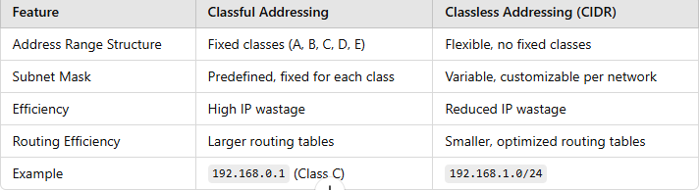
IPv4 is further classified as:
Classless Addressing
Classfull Addressing

Slide 6
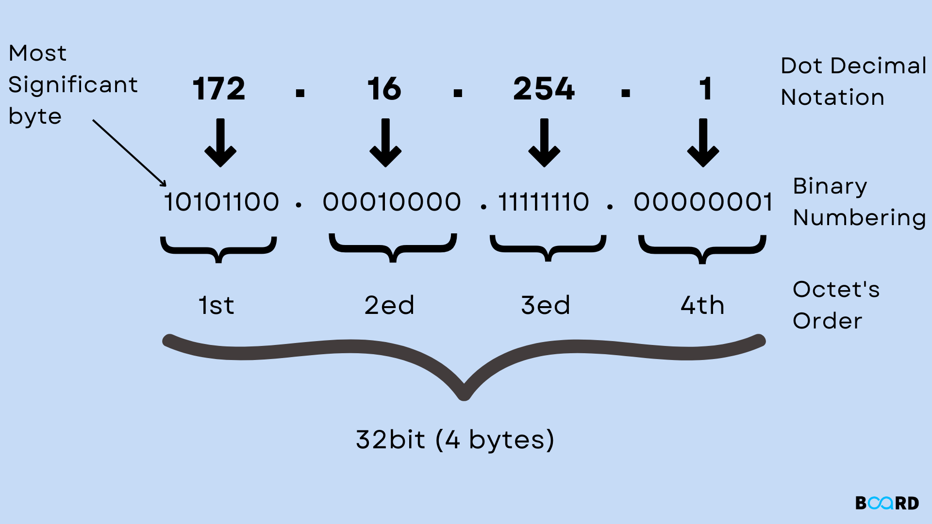
Classful addressing, Logical addressing,
An IPv4 addressing architecture known as classful addressing splits addresses into five classes.
The first eight bits of an IP address formerly identified the network that a particular host belonged to.

Slide 7
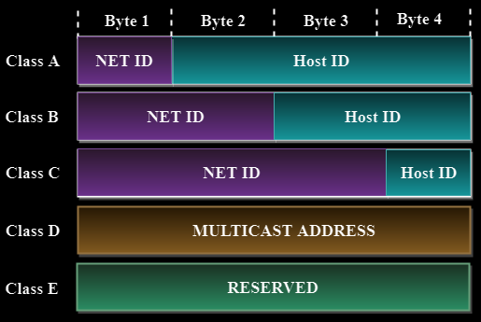
Components of IP Address
There are two components to an IP address:
Network ID: This identifies how many networks there are.
Host ID: This identifies how many hosts there are.

Slide 8
An IP address is 32-bit long. An IP address is divided into sub-classes:
CLASS A | 0-127 | 0
CLASS B | 128-191 | 10
CLASS C | 192-223 | 110
CLASS D | 224-239 | 1110
CLASS E | 240-255 | 1111

Slide 9
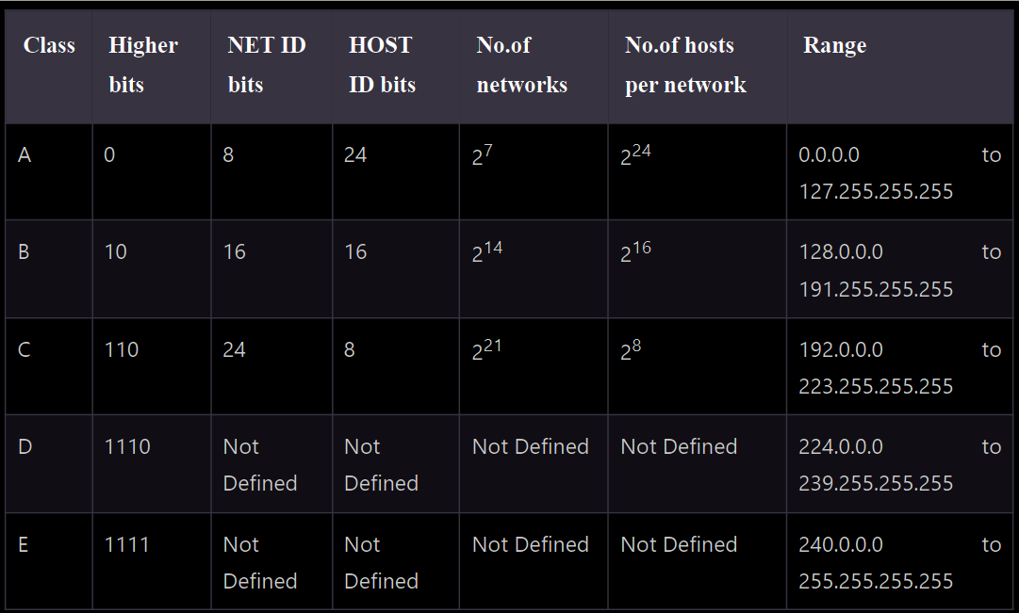
The five different types of Classful addresses are Class A, Class B, Class C, Class D, and Class E.
This division is referred to as Classful addressing or IP address classes in IPv4.

Slide 10
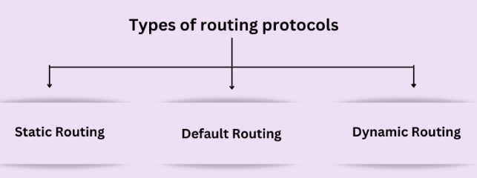
Routing Algorithm
Routing protocols are the set of rules and algorithms that routers use to communicate with each other to find the most efficient path to transmit data packets from a sender to a receiver.

Slide 11
Static Routing Protocol
It can also be called non-adaptive routing.
It is a manual configuration technique in which the network administrator selects the best path to transfer the data packet from source to destination.
When a network administrator configures each router in the routing table by hand, it is called static routing.
The router forwards the data packets to the destination along the path defined by the network administrator.
Default Routing Protocol
The default routing protocol can also be called the default route.
When a router faces a situation where it does not know the destination network of a data packet, then it uses a method called "default routing".
It is an approach in which the router transfers all data packets to the single-hop device, regardless of the network.
The default route is the predetermined path the router uses to send all data packets when encountering such a situation.

Slide 12
Dynamic Routing Protocol
It can also be called adaptive routing.
It is an approach in which a router automatically finds the best path to transmit data packets from the sender to the receiver and puts the selected path information into the routing table of each router.
The router selects the path based on situations of the communication circuit or the network topology.
If there is any loss of connection between the nodes or there is a problem with the route decided, the packed data is automatically adjusted on the new route to be forwarded towards the destination. It is ideal for larger organizations where many routers are used.

Slide 13
Types of Dynamic Routing Protocols
Dynamic Routing Protocol
Interior Gateway Protocol
Link State Routing Protocol
Distance Vector Routing Protocol
Exterior Gateway Protocol
Path Vector Routing Protocol
OSPF
RIP
BGP

